Slide 1
527 Data Analytics
March 24, 2016
Housing Tax Strategy

Slide 2
Week # Topic: Housing Tax Strategy Intro/Background
Objectives:
Analyze the data of 2013 property tax in Illinois State and propose a new tax strategy.
Data Source:
AMERICAN COMMUNITY SURVEY 2013 ACS 1-YEAR PUMS FILES
---Prepared by American Community Survey Office U.S. Census Bureau

Slide 3
Week # Topic: Housing Tax Strategy Methodology and Clustering Variable
Methodology and Model Selection
FASTCLUS procedure for k=25 is performed to keep the total number of the member in one cluster less than 10,000.
Selection of variables
HINCP and VALP have the similar scales and more complete data. They are the important factors to measure the tax burden, are selected as the base numerical variables for clustering.
HINCP: Household income (past 12 months)
VALP: Property value
To get better results, seven additional variables are used for profiling:
TAXP: Property taxes (yearly amount)
BLD: Type of building
TEN: Tenure
YBL: When structure first built
WIF: Workers in family during the past 12 months
MV: When moved into this house or apartment
WORKSTAT: Work status of householder or spouse in family households

Slide 4
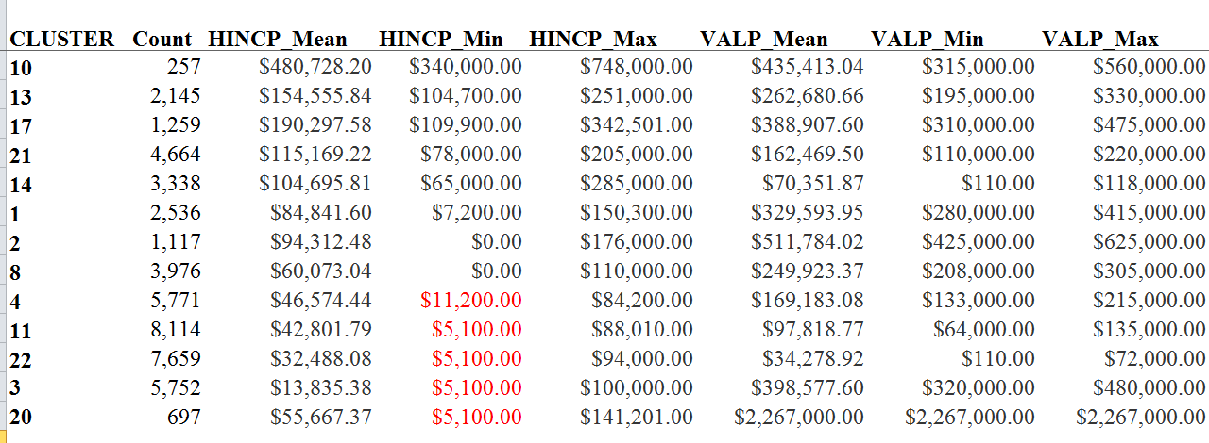
Week # Topic: Housing Tax Strategy Clustering Analysis
The Clustering analysis was performed based on SAS. Below is the cluster results from analysis. After the clusters are examined in details, cluster 3 and 20 are not used for the further analysis since too many VALP are missed. Analysis are performed based on rest of clusters.

Slide 5
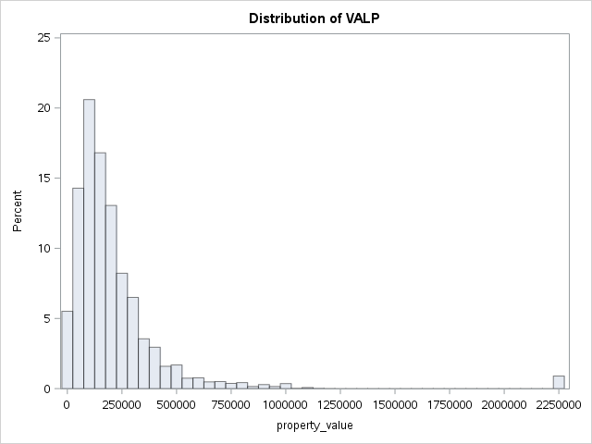
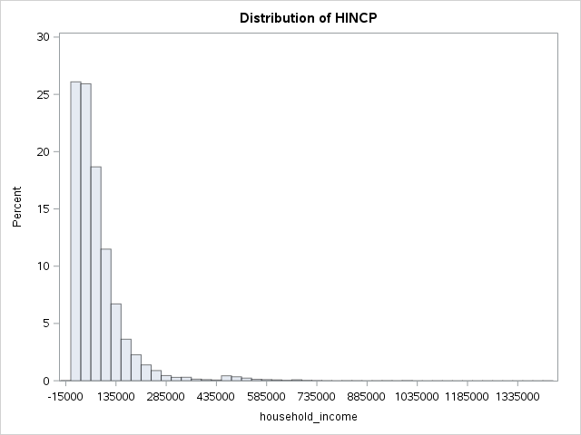
Week # Topic: Housing Tax Strategy Cluster analysis
Data Analysis results show
The distribution of HINCP and VALP is highly right skewed. The dense zone of HINCP is from -$10,000 to $11,000. The dense zone of VALP is from $50,000 to $250,000.

Slide 6
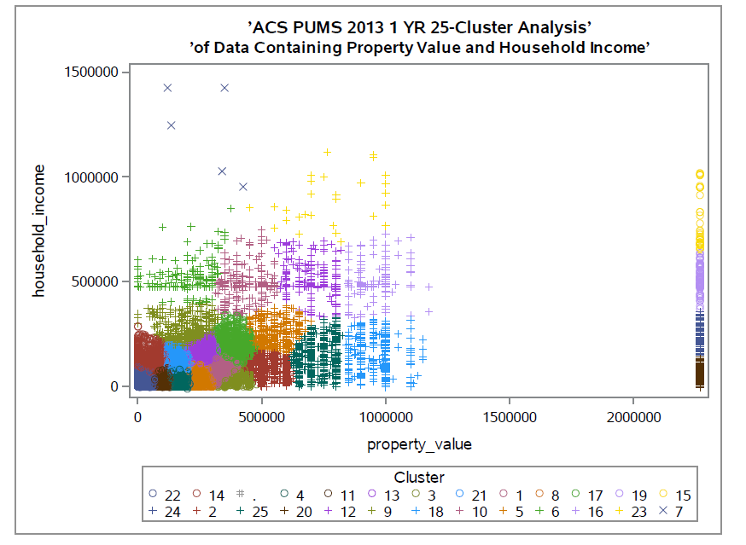
Week # Topic: Housing Tax Strategy Cluster analysis
See the results from SAS
There are 4 clusters in the right-bottom outliers and 2 clusters in the left-top outliers.
There are 4 clusters which have 5,000 to 8,000 members, 7 clusters which have 1,000 to 5,000 members, 11 clusters which have 100 to 1,000 members and 3 clusters which has less than 100 members.
The cluster mean value of HINCP is from $13,835.38 to $1,215,200.00
The cluster mean value of VALP is from -$11,200.00 to $953,000.00

Slide 7
Week # Topic: Housing Tax Strategy Profiling of clusters
Group A:
Clusters: 12, 15, 16, 18, 19, 23, 24, 25
High Income, High Property Value Owners
Paying above $10k in property taxes already (TAXP=68)
Group B:
Clusters: 5, 6, 7, 9, 10, 13, 17, 21
High Income, Mid Property Value Owners
Owned one family house
Paying above $5k in property taxes already
Group C:
Clusters: 14
Mid-high Income, Low Property Value Owners
Owned one single family house and moved in 20 to 30 years ago
Paying above $1.5k in property taxes already
Income Category:
<35k | very low
<49k | low
50k-100k | mid
100k-200k | mid-high
>200k | high
Property Category:
>2M | max
>700k | high
500k-700k | mid-high
250k-500k | mid
100k-250k | mid-low
<100k | low

Slide 8
Week # Topic: Housing Tax Strategy Profiling of clusters
Group D:
Clusters: 1, 2, 8
Mid-high Income, Mid Property Value Owners
Unemployed or No workers
Paying above $5k in property taxes already
Group E:
Clusters: 4, 11, 22
Low levels
Unemployed, woman household,
or single worker household
Paying low range property taxes
Income Category:
<35k | very low
<49k | low
50k-100k | mid
100k-200k | mid-high
>200k | high
Property Category:
>2M | max
>700k | high
500k-700k | mid-high
250k-500k | mid
100k-250k | mid-low
<100k | low

Slide 9
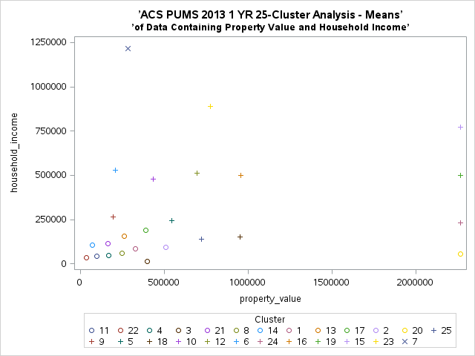
Week # Topic: Housing Tax Strategy Profiling of clusters
A
High Income, High Property Value

Slide 10
Week # Topic: Housing Tax Strategy Profiling of clusters
B
High Income
Mid Property Value
Owned one family house

Slide 11
Week # Topic: Housing Tax Strategy Profiling of clusters
C
Mid-high Income
Low Property Value
Owned one single family house
and moved in 20 to 30 years ago

Slide 12
Week # Topic: Housing Tax Strategy Profiling of clusters
D
Mid-high Income
Mid Property Value
Unemployed or No workers

Slide 13
Week # Topic: Housing Tax Strategy Profiling of clusters
E
Low levels
Unemployed,
woman household,
or single worker household

Slide 14
Week # Topic: Housing Tax Strategy Tax increase strategy
General Scheme for Tax Increases:
Households currently making less than $50k will incur no tax increases
Households currently making more than $50k and less than $100k, property tax will increase by 10%
Households currently making more than $100k per household, paying low tax 1 ($0) ~ 31 (<$2000), will pay an additional 20% for the property tax
Households currently paying taxes in the 32 (>$2000) ~ 51 (<$4000) range, property tax will increase by30% if household income is higher than $1000k.
Households currently paying taxes in the 52 (>$4000) ~ 67 (<$ 10000) range, will pay an additional 40% property tax if household income is higher than $1000k.
Households currently paying taxes of 68 (>$10000), will pay an additional 50% property tax if household income is higher than $1000k.

Slide 15
Week # Topic: Housing Tax Strategy Optimum return on strategy
Group | Cluster | Tax Increase | Total
Group A | 12 | $516,927.70 | $2,677,025.90
 | 15 | $102,500.00
 | 16 | $311,827.50
 | 18 | $449,320.70
 | 19 | $249,964.50
 | 23 | $73,399.80
 | 24 | $184,443.70
 | 25 | $788,642.00
Group B | 5 | $1,294,611.00 | $15,914,416.55
 | 6 | $262,646.40
 | 7 | $8,664.35
 | 9 | $1,011,334.00
 | 10 | $630,010.80
 | 13 | $4,845,664.00
 | 17 | $3,203,392.00
 | 21 | $4,658,094.00
Group C | 14 | $922,447.70 | $922,447.70
Group D | 1 | $2,234,783.00
 | 2 | $1,169,190.00
 | 8 | $1,210,022.00 | $4,613,995.00
Group E | 4 | $890,085.60
 | 11 | $634,572.10
 | 22 | $69,102.10 | $1,593,759.80
 |  | Total: | $25,721,644.95

Slide 16
Week # Topic: Housing Tax Strategy Conclusions
The FASTCLUS analysis was performed for the data of 2013 property tax in Illinois State. Based on the analysis, twenty five clusters were divided into five groups, i.e., A,B,C,D,E.
Tax increasing strategy for each group was proposed. Tax burden for each group will increase by 0 ~ 50% based on their income, current property tax, etc. See slide 15. It will not reduce the living standard for low incomer.
The proposal will create additional revenue $25,721,644.95.

